Slide 2
1. Query all IMEx databases or mentha using PSICQUIC for interactions for species:”Species_ID”
2. Transform pairs of interactions into the list of interactors and filter out interactors from other species or non-proteins
Protein from selected species (e.g. human)
Protein from the other species (e.g. mouse)
1
1
2
2
non-Uniprot ID (e.g. RNA or small molecule or …)
3
4
3
5
6
5
1. Query Uniprot for the reference proteome using proteome:Proteome_ID
2. Query Uniprot for the whole proteome using organism:SPECIES_ID
3. Filter proteomes to get all UniprotKB, SwissProt or trEMBL only
4. Uniprot query result contains ‘generic’ identifiers and isoform IDs in separate columns, so – extract isoform IDs and combine them with the ‘generic’ identifiers
1. Change isoform -1 to classical name both in interactors and proteome (e.g. O14746-1 to O14746)
2. filter for unique IDs both in interactors and proteome

Slide 3
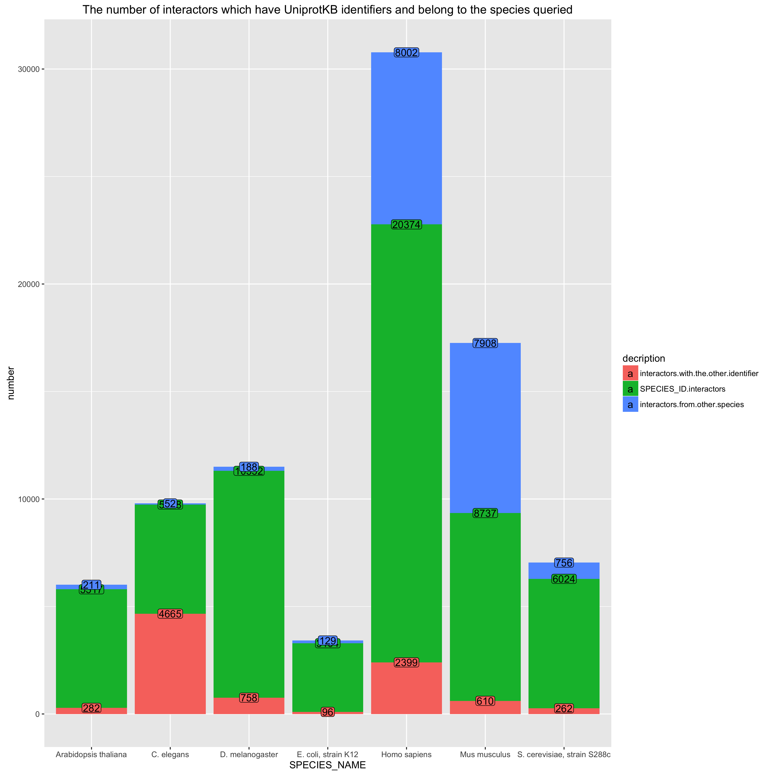
IMEx
Protein from selected species (e.g. human)
Protein from the other species (e.g. mouse)
non-Uniprot ID (e.g. RNA or small molecule or …)
1
2
3
4
5
6
1
2
3
5

Slide 4
1
IntAct
IntAct
MINT
IMEx
whole proteome reference
1
MINT
1
1
1
1
1
0
IntAct
MINT
IMEx
2
IntAct
2
1
0
1
1
1
1
1
1
1
3
IntAct
3
1
0
1
1
1
2
1
0
1
5
MINT
5
0
1
1
1
1
3
1
0
1
6
0
0
0
1
1
5
0
1
1
7
0
0
0
1
1
8
0
0
0
1
1
9
0
0
0
1
0
Compare list of interactors (in particular database or IMEx combined) to the list of proteins in reference or whole proteome

Slide 5
Interactome vs proteome
November 2016

Slide 6
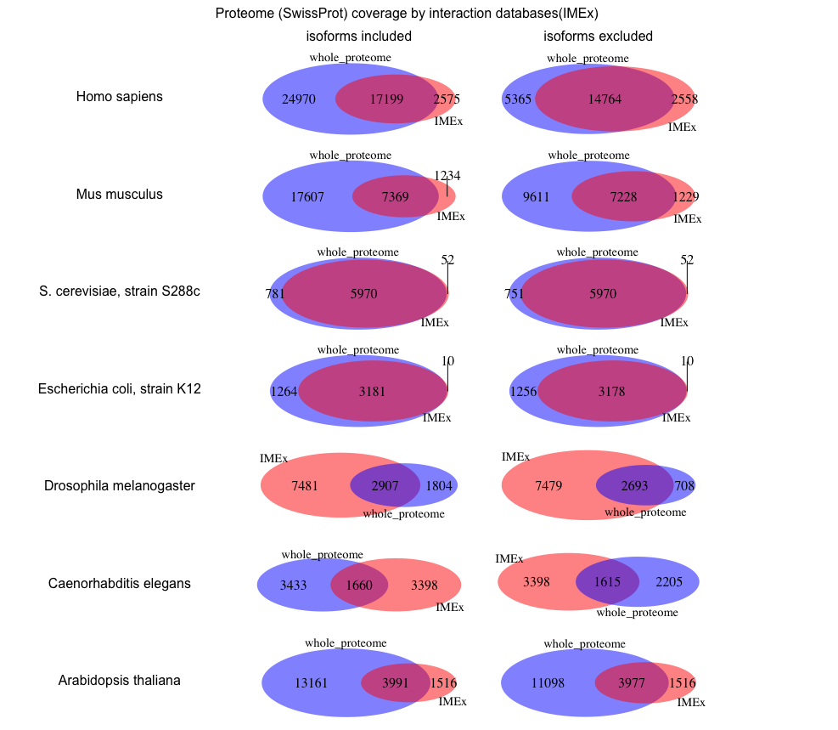
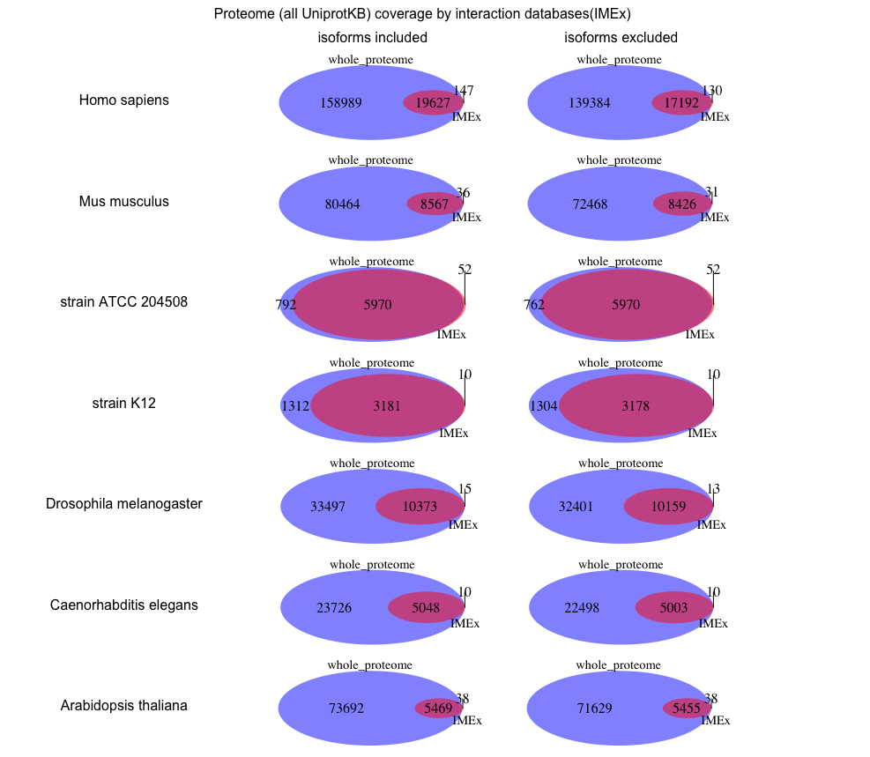
interactome:
all IMEx databases

Slide 7
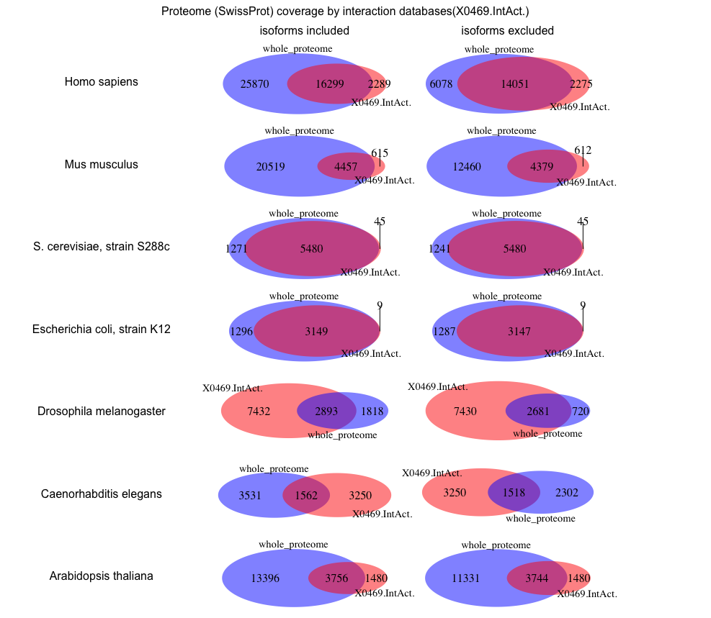
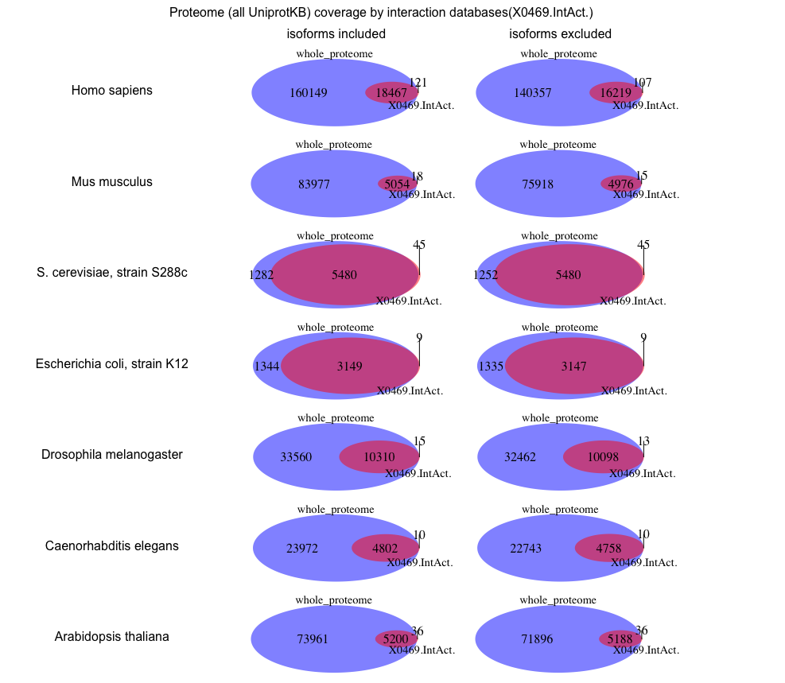
interactome:
IntAct only

Slide 8
Conclusion I
Overall - the best interactome annotated by IMEx databases is baker’s yeast, 2nd best interactome is E.coli
All other interactomes cover less than the half of their respective proteome (all UniprotKB)
overlap between the interactome and reviewed proteome (SwissProt) looks much better
A large fraction of human, mouse, arabidopsis interactors and more than a half of drosophila and C.elegans interactors are absent in SwissProt – under-annotation by Uniprot
protein isoforms (in multicellular model organisms) are almost not annotated in the interactome
Human is the exception – 2452 protein isoforms out of 21957
For most organisms in my list (with the exception of mouse) IntAct overlaps to a large extent with the other IMEx databases
No interactions at all for naked mole rat!!!

Slide 9
Interactome vs proteome vs missing protein evidence
November 2016

Slide 10
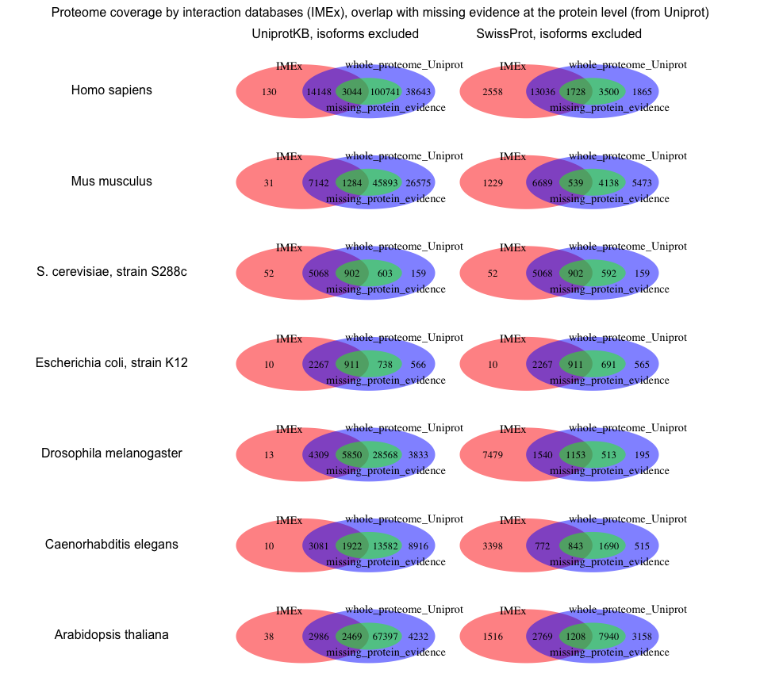
all IMEx databases
Whole proteome
Missing proteins evidence

Slide 11
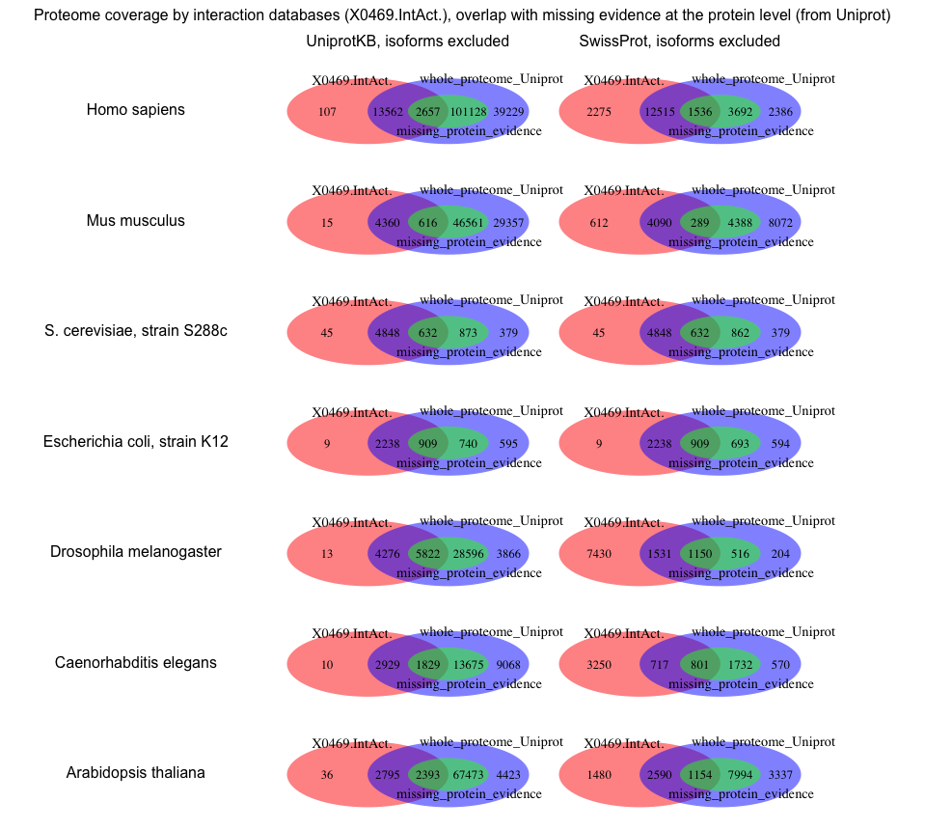
all IMEx databases
Whole proteome
Missing proteins evidence

Slide 12
Conclusion II
With exception of yeast, E.coli and drosophila there is trend:
more proteins which are missing protein evidence in Uniprot it is also absent in IMEx interaction databases than proteins which are missing protein evidence in Uniprot and are present in IMEx
--- some of the proteins missing protein evidence in SwissProt are present in IntAct – suggesting list of proteins (and publications) for SwissProt curators

Slide 13
Interactome vs proteome vs BioDRID
November 2016

Slide 14
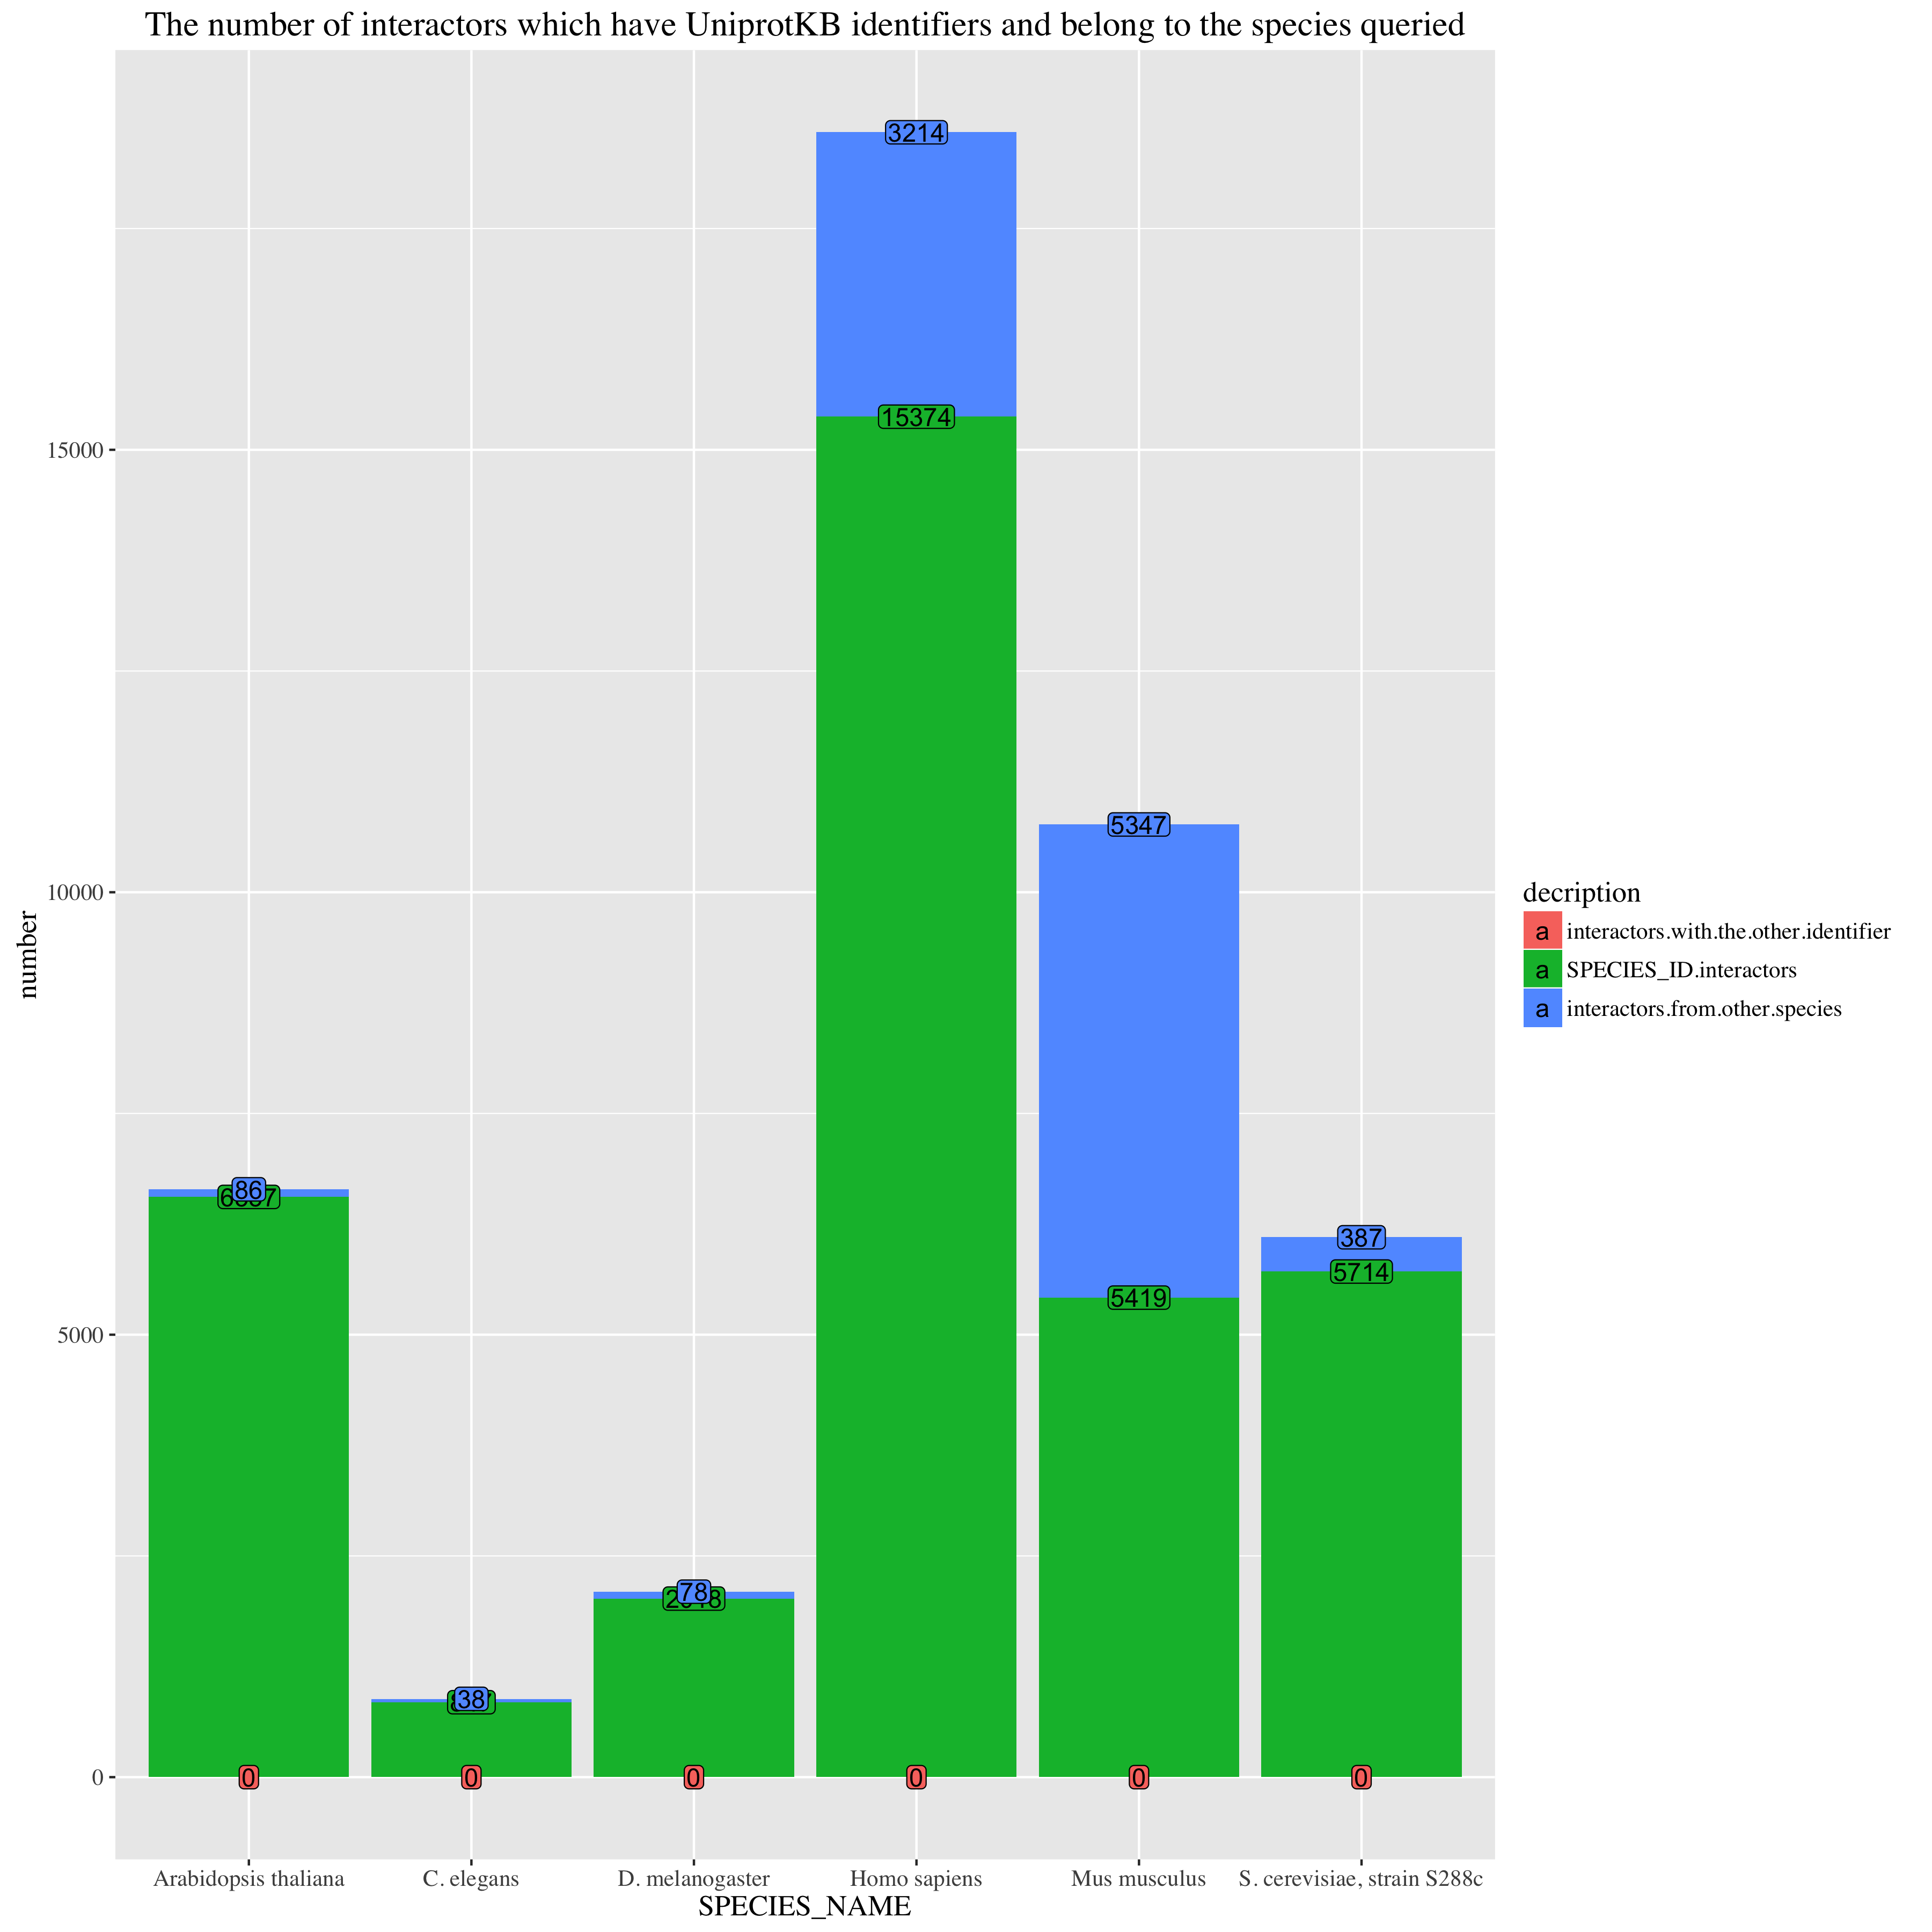
BioGRID from Mentha
Protein from selected species (e.g. human)
Protein from the other species (e.g. mouse)
non-Uniprot ID (e.g. RNA or small molecule or …)
1
2
3
4
5
6
1
2
3
5

Slide 15
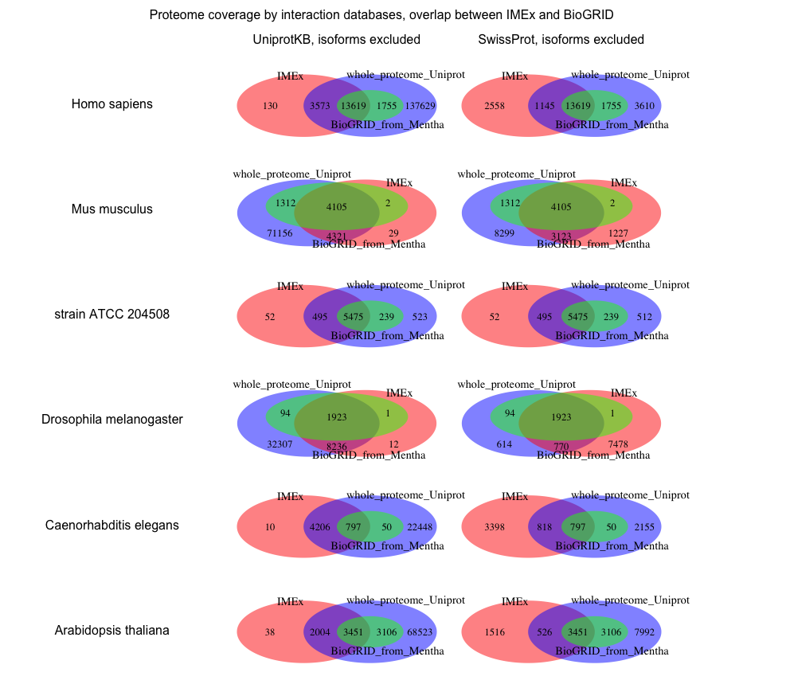
all IMEx databases
Whole proteome
BioGRID from mentha

Slide 16
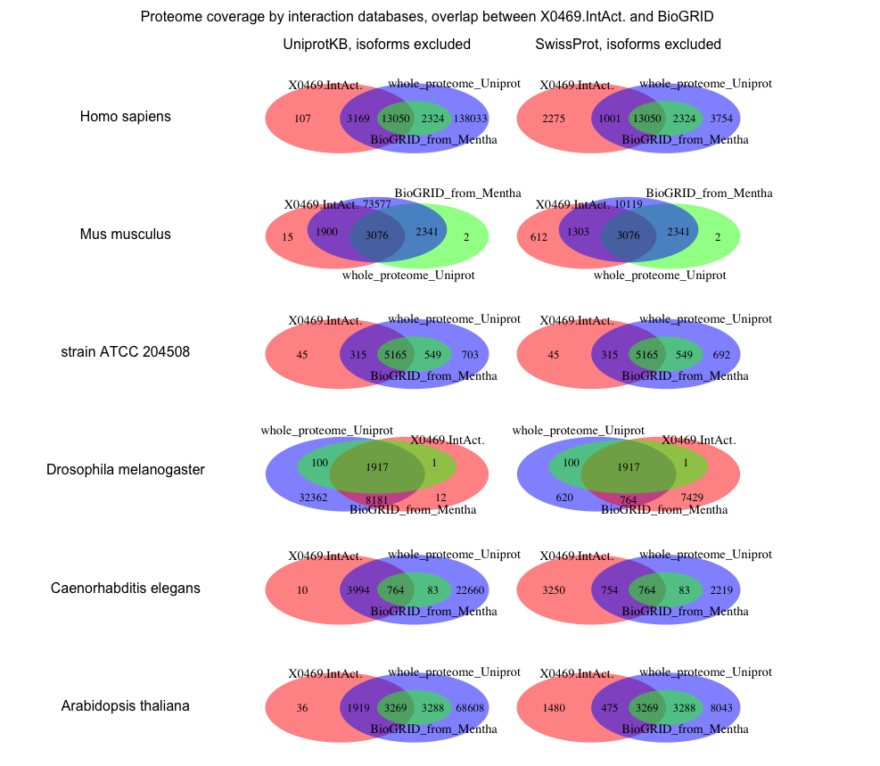
IntAct only
Whole proteome
BioGRID from mentha

Slide 17
Conclusion III
Scientists like to put proteins from other species into mouse experiments: half of the interactors are from other species, but to be more conclusive I need to look which proteins are baits
Holds true for both IMEx databases and for BioGRID
All BioGRID proteins are found in SwissProt
BioGRID and IMEx largely overlap
no "E.coli strain K12" in BioGRID from Mentha

Slide 18
Interactome vs proteome more species – exploratory bar graphs
November 2016

Slide 19
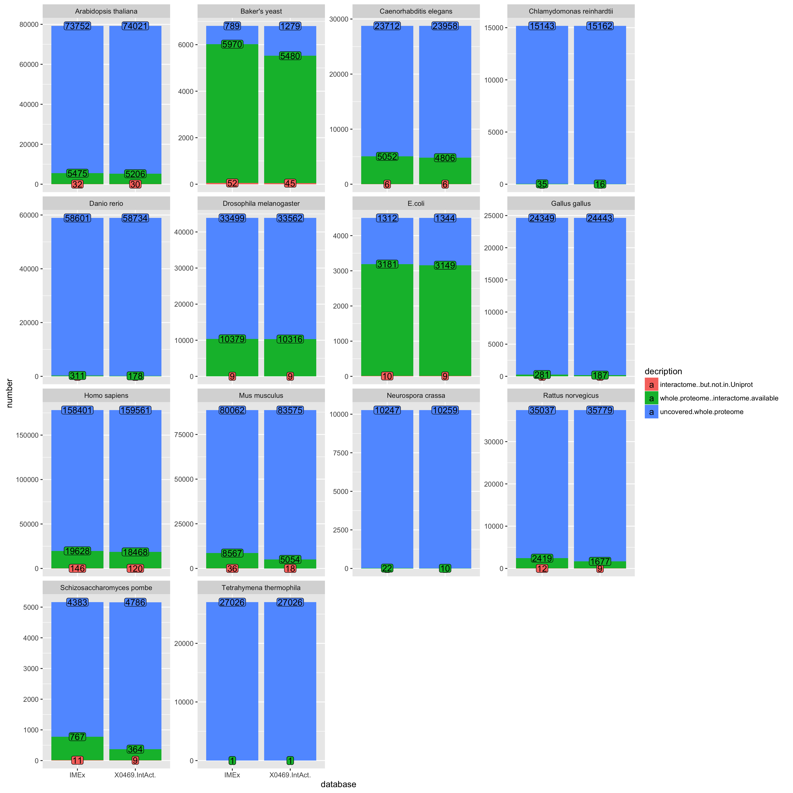
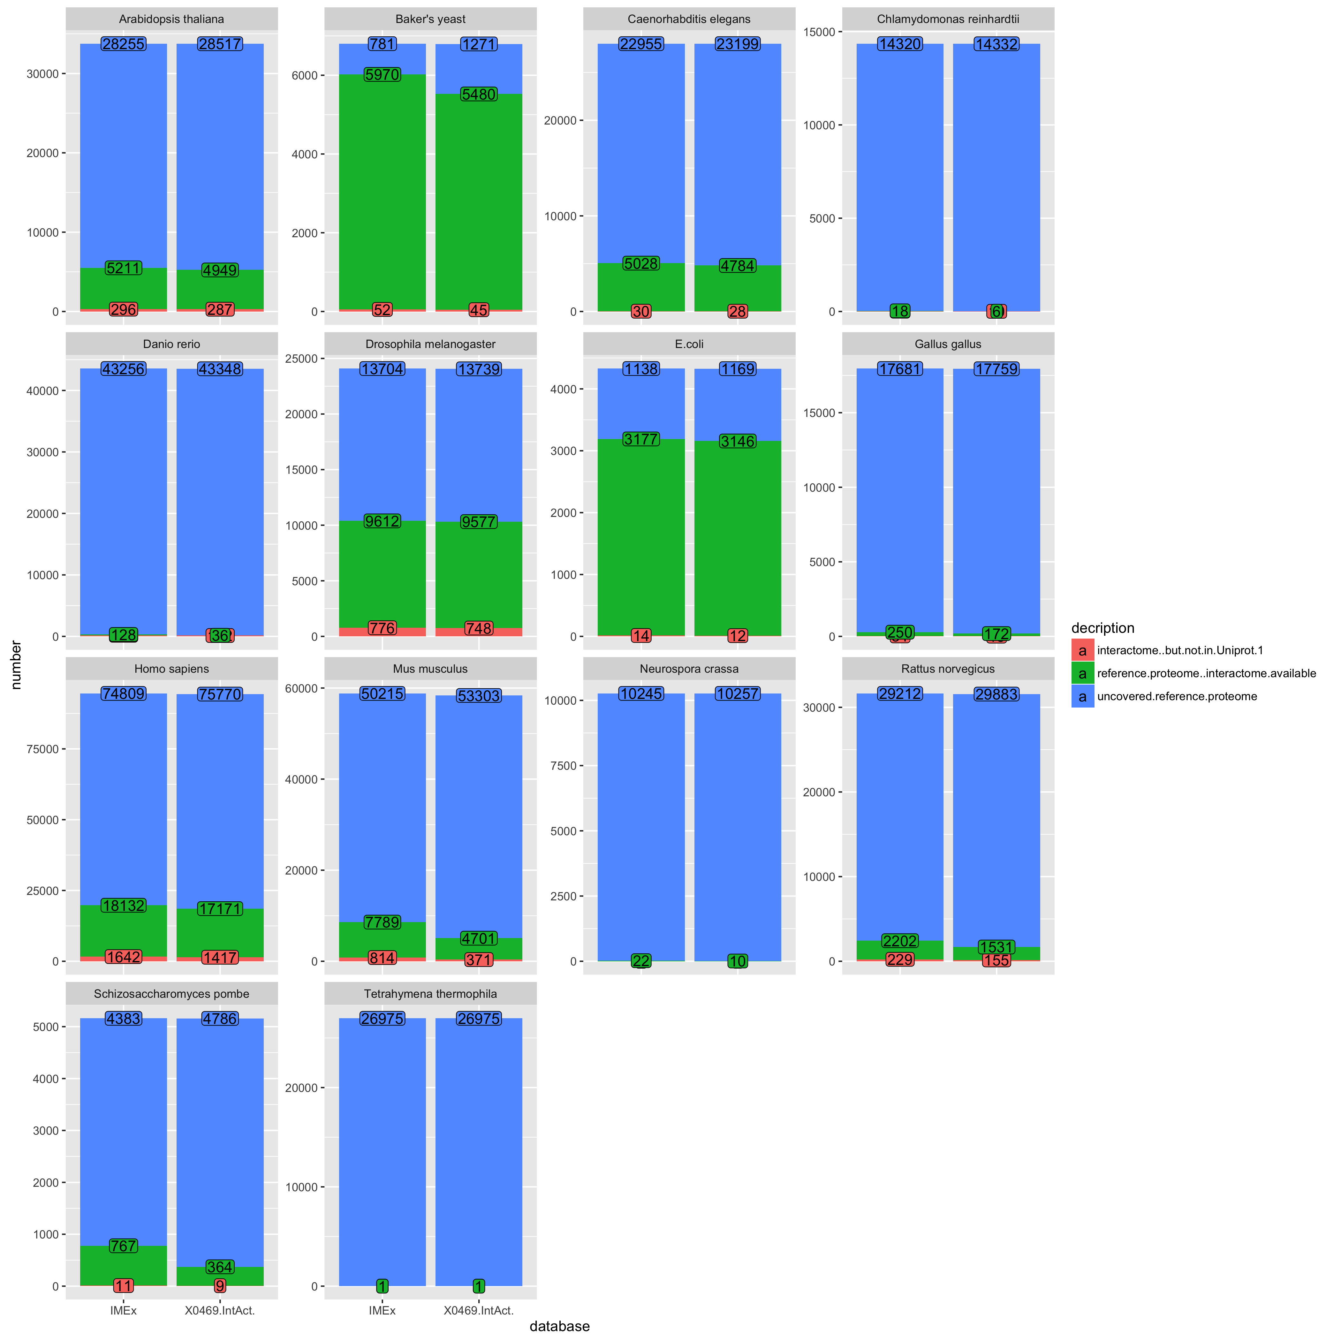
Whole proteome vs interactome
Reference proteome vs interactome
all IMEx – IntAct only
all IMEx – IntAct only

Slide 20
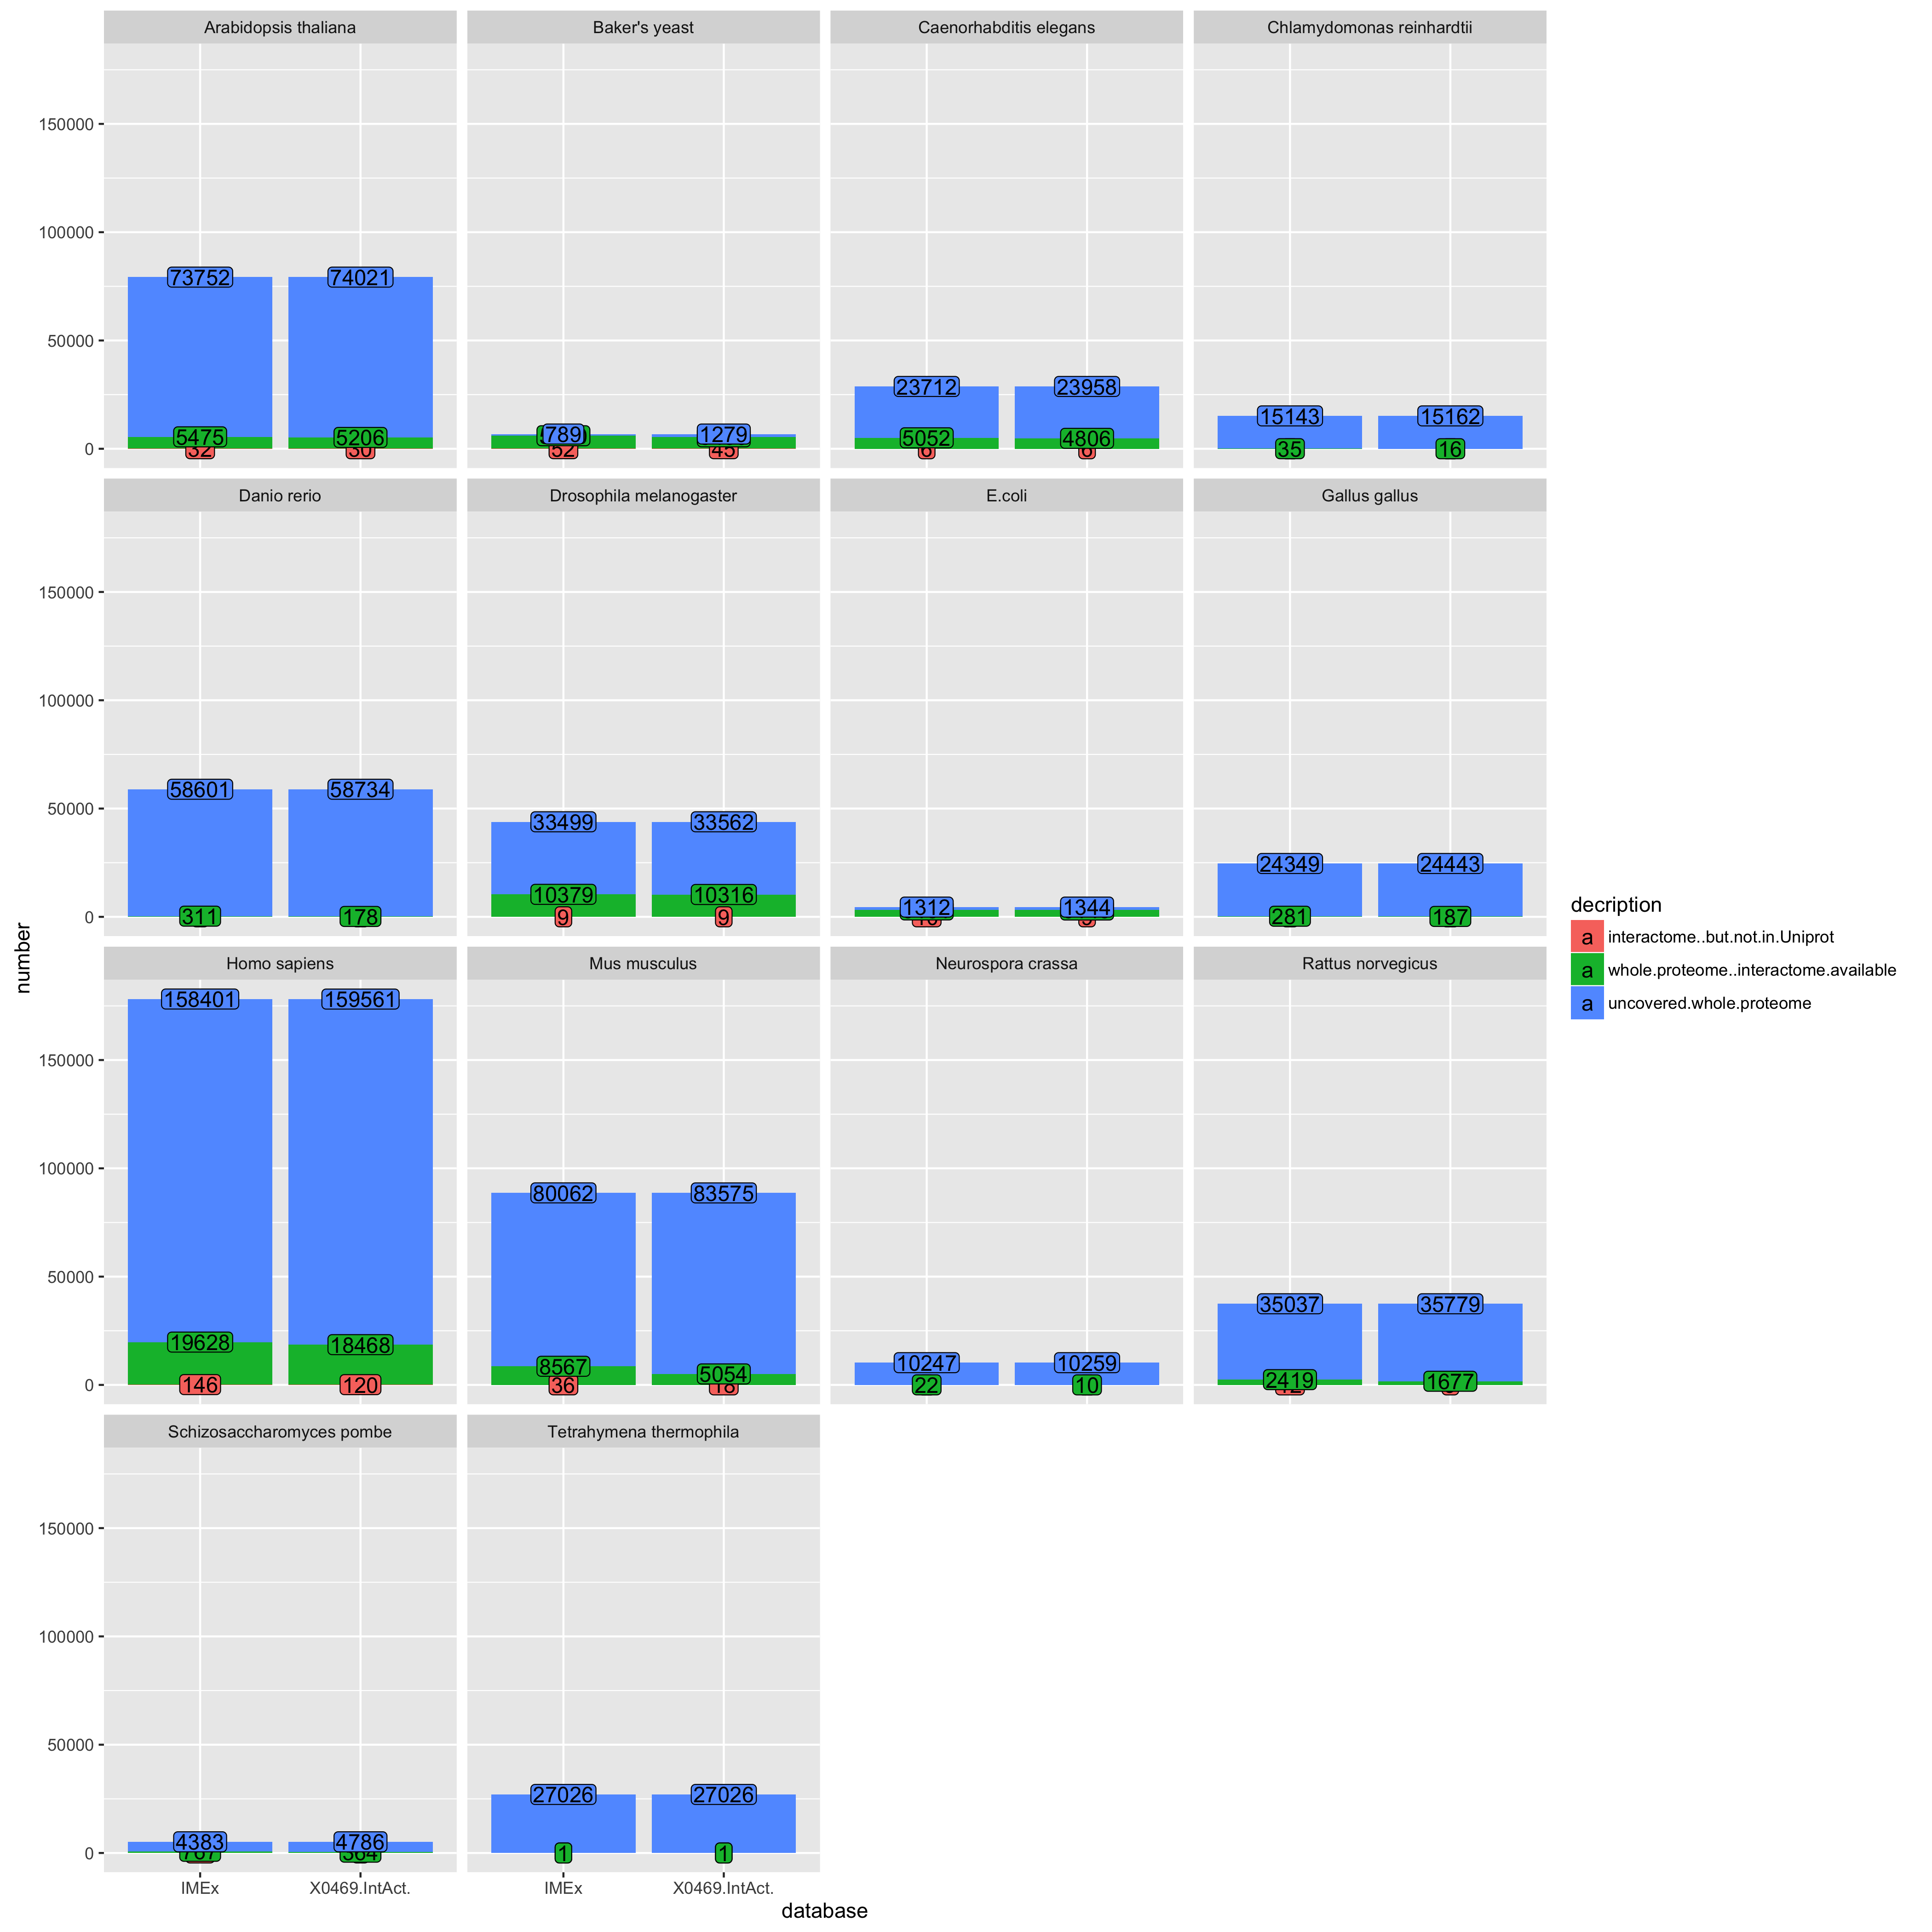
Whole proteome vs interactome
Reference proteome vs interactome
all IMEx – IntAct only
all IMEx – IntAct only

Slide 21
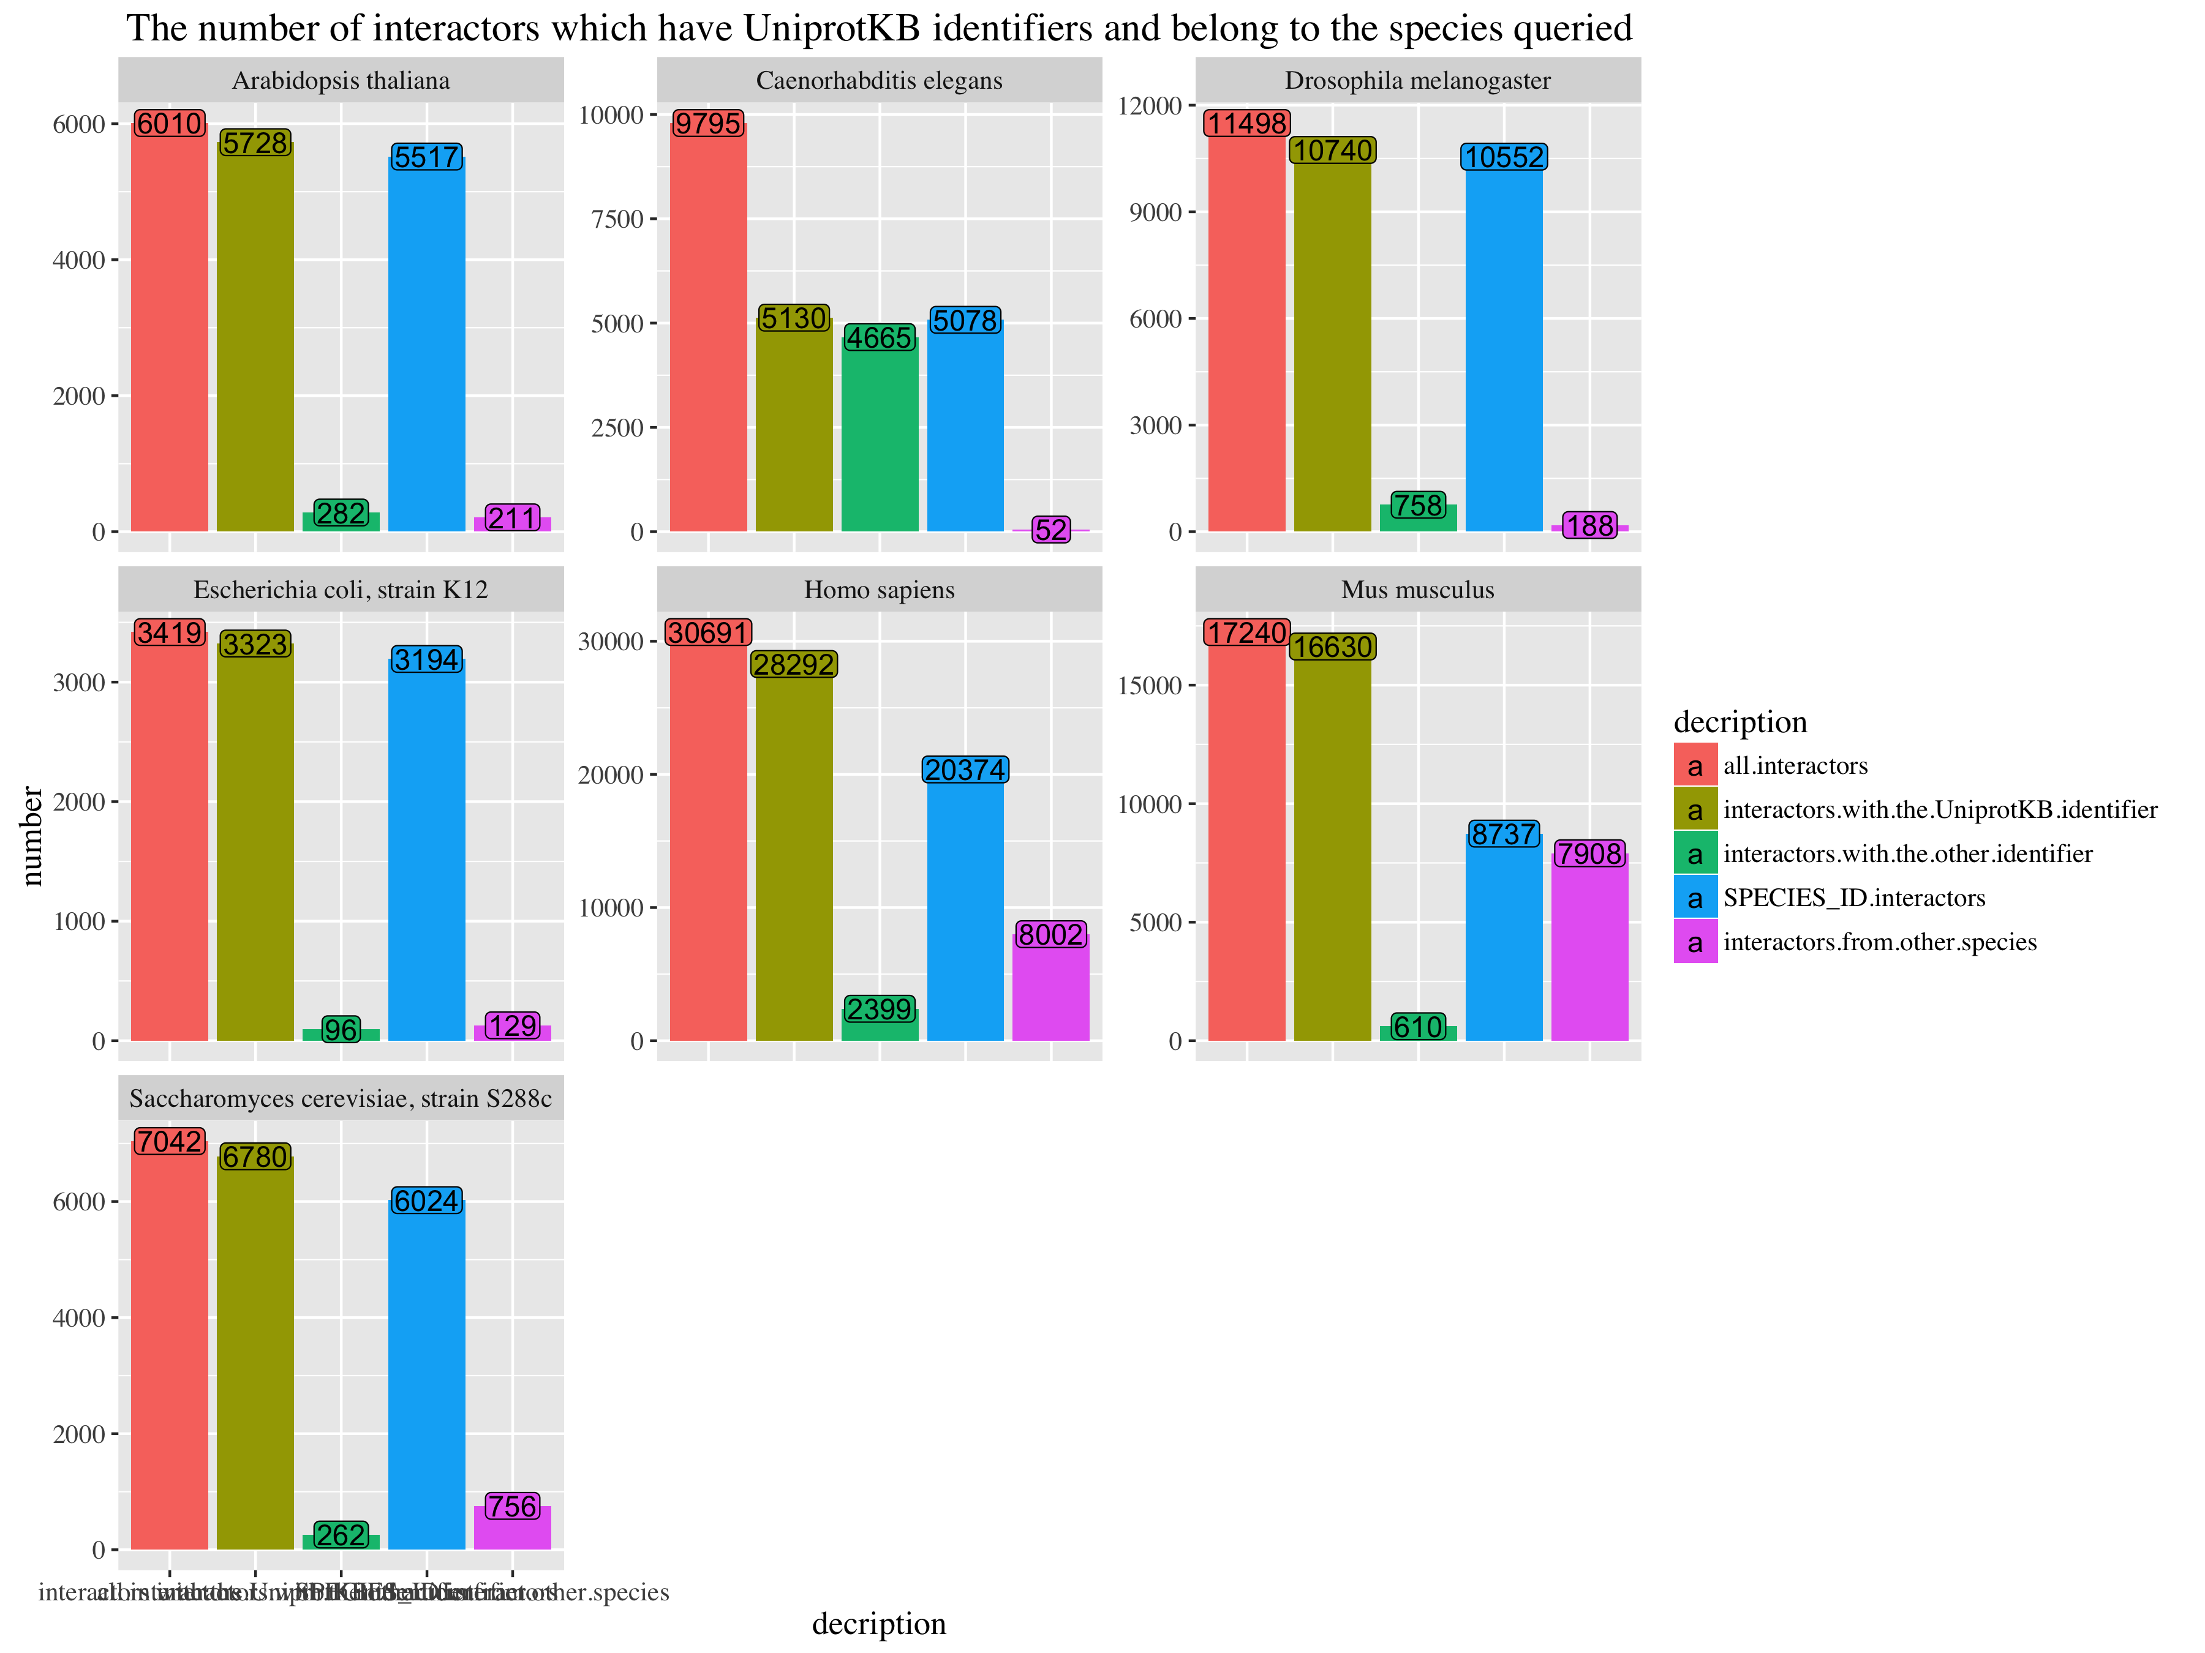
IMEx
Protein from selected species (e.g. human)
1
1
2
Protein from the other species (e.g. mouse)
2
3
4
non-Uniprot ID (e.g. RNA or small molecule or …)
3
5
6
5

